Slide 1
Python
String and Text
in programming

Slide 2
Strings
Computers do not deal with characters, they deal with numbers (binary). Even though you may see characters on your screen, internally it is stored and manipulated as a combination of 0s and 1s.
A string is a sequence of characters.
In Python, a string is a sequence of Unicode characters.
As, there are many written languages in the world, Unicode was introduced to include every character in all languages

Slide 3
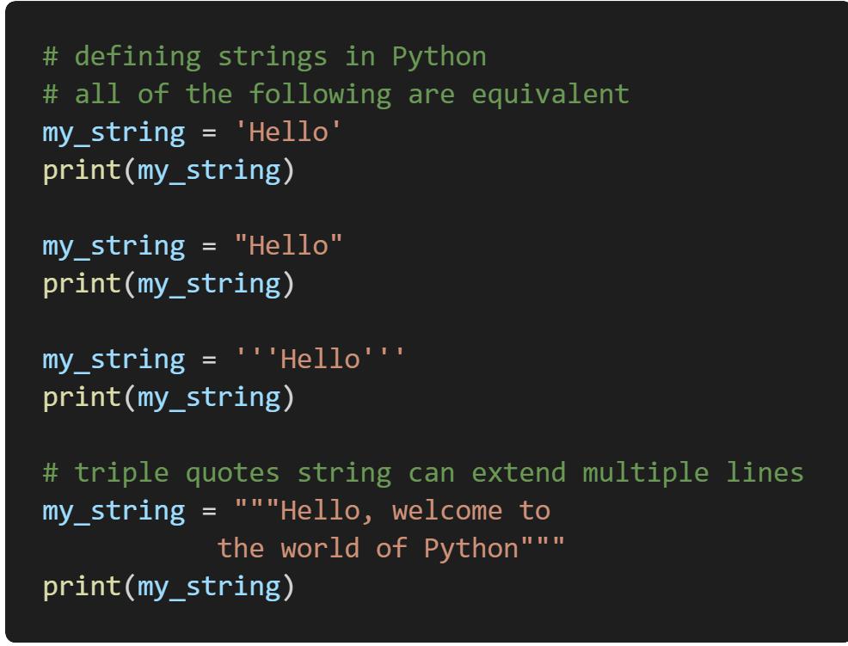
Create a string in Python
Strings can be created by enclosing characters inside a single quote or double-quotes
Even triple quotes can be used in Python but generally used to represent multiline strings and docstrings.

Slide 4
Indexing in strings
We can access individual characters using indexing
Python allows negative indexing for its sequences.
Negative index
-9
-8
-7
-6
-5
-4
-3
-2
-1
s
o
p
h
o
m
o
r
e
Positive index
0
1
2
3
4
5
6
7
8
Trying to access a character out of index range will raise an IndexError. The index must be an integer.

Slide 5
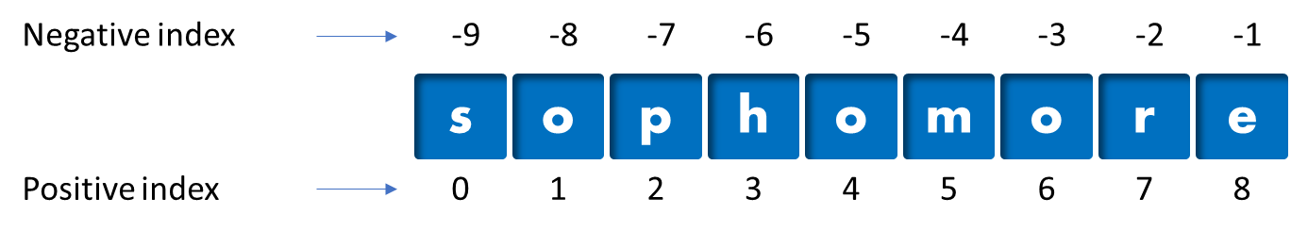
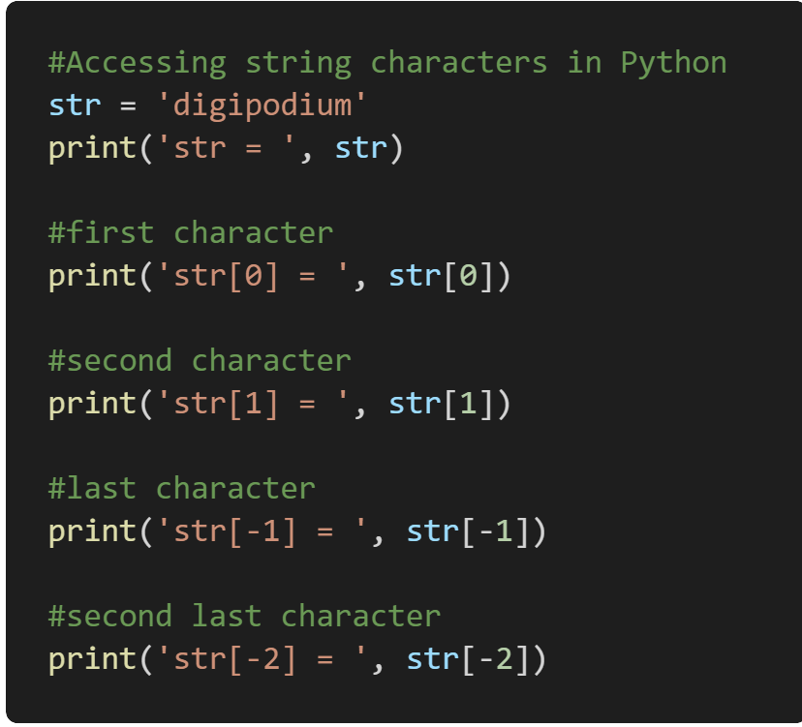
Indexing in strings
x =
s
x[0]
h
x[3]
e
x[-1]

Slide 6
String Slicing
Python also allows a form of indexing syntax that extracts substrings from a string, known as string slicing.
If s is a string, an expression of the form s[ m : n ] returns the portion of s starting with position m, and up to but not including position n
2
6
E
N
C
Y
C
L
O
P
E
D
I
A
6+1
S [2 : 7]
Last index is exclusive
C
Y
C
L
O

Slide 7


String Slicing
If you omit the first index, the slice starts at the beginning of the string. Thus, s[:m] and s[0:m] are equivalent
Same logic works when you omit the last part of slice

Slide 8
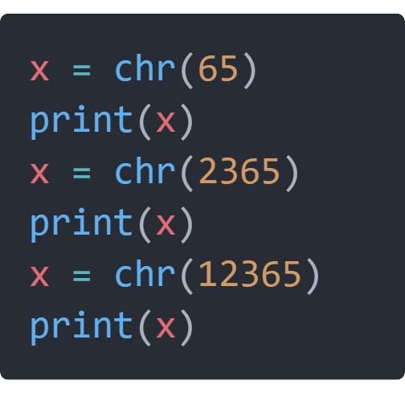
Builtin function for Strings
Try it yourself
These are python functions that are used directly on string for specific output. Below are some important functions
chr( ) - convert integer to string char
ord( ) - convert a char to integer
len( ) - returns length of string
str( ) - converts items to string

Slide 9
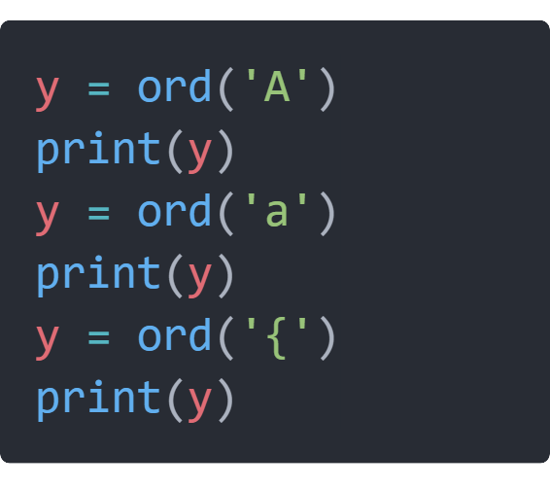
Builtin function for Strings
Try it yourself
These are python functions that are used directly on string for specific output. Below are some important functions
chr( ) - convert integer to string char
ord( ) - convert a char to integer
len( ) - returns length of string
str( ) - converts items to string

Slide 10
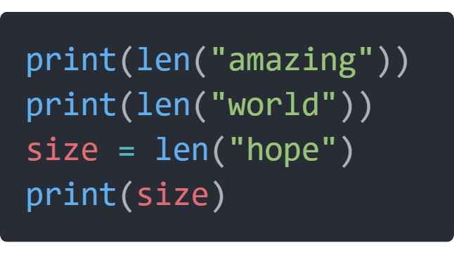
Builtin function for Strings
Try it yourself
These are python functions that are used directly on string for specific output. Below are some important functions
chr( ) - convert integer to string char
ord( ) - convert a char to integer
len( ) - returns length of string
str( ) - converts items to string

Slide 11
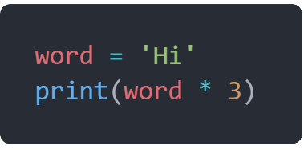
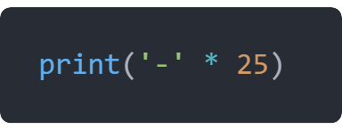
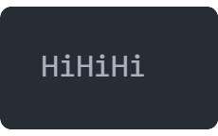
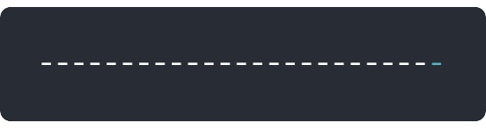
String operations
duplication
In python we can multiply a string with int, which will give a sequence of duplicated strings

Slide 12
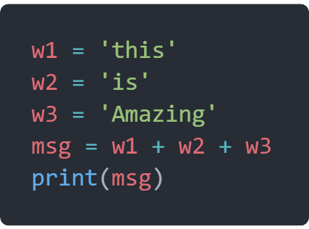
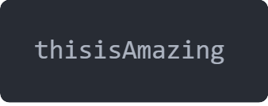
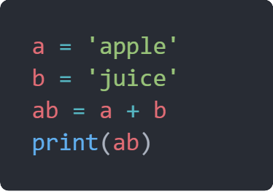
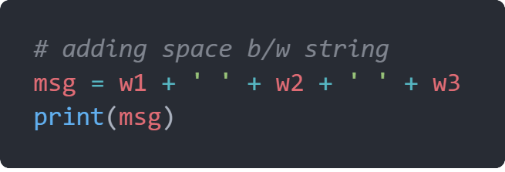
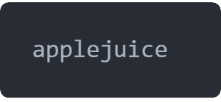
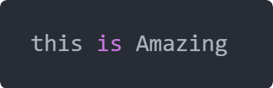
String operations
concatenation
The concept of joining 2 or more string together, to create a new string

Slide 13
String functions

Slide 14
Must Know String Functions
Function | Description
format() | It’s used to create a formatted string from the template string and the supplied values.
split() | Python string split() function is used to split a string into the list of strings based on a delimiter.
join() | This function returns a new string that is the concatenation of the strings in iterable with string object as a delimiter.
strip() | Used to trim whitespaces from the string object.
upper() | We can convert a string to uppercase in Python using str.upper() function.
lower() | This function creates a new string in lowercase.
replace() | Python string replace() function is used to create a new string by replacing some parts of another string.
find() | Python String find() method is used to find the index of a substring in a string.

Slide 15
Question in Strings
Q. Write a program to replace all special character with _
Q. Write a program to remove all vowels in a string
Q. Write a program to remove all special characters in a string

Slide 16
Good to know String Functions
Function | Description
count() | Python String count() function returns the number of occurrences of a substring in the given string.
startswith() | Python string startswith() function returns True if the string starts with the given prefix, otherwise it returns False.
endswith() | Python string endswith() function returns True if the string ends with the given suffix, otherwise it returns False.
capitalize() | Python String capitalize() function returns the capitalized version of the string.
center() | Python string center() function returns a centered string of specified size.

Slide 17
Question in Strings
Q. Write a program to count all the characters in a string
Q. Write a program to count all the words in a string
Q. Write a program to count all the special characters in a string

Slide 18
Miscellaneous String Function
Function | Description
isalnum() | Python string isalnum() function returns True if it’s made of alphanumeric characters only.
isalpha() | Python String isalpha() function returns True if all the characters in the string are alphabets, otherwise False.
isdecimal() | Python String isdecimal() function returns True if all the characters in the string are decimal characters, otherwise False.
istitle() | Python String istitle() returns True if the string is title cased and not empty, otherwise it returns False.
isupper() | Python String isupper() function returns True if all the cased characters are in Uppercase.
rjust(), ljust() | Utility functions to create a new string of specified length from the source string with right and left justification.
swapcase() | Python String swapcase() function returns a new string with uppercase characters converted to lowercase and vice versa.

Slide 19
Builtin String Functions
Function | Description
len() | Python String length can be determined by using built-in len() function.
chr() | Prints the char from Unicode after passing a number
bool() | Python bool() function returns Boolean value for an object. The bool class has only two instances – True and False.
ord() | Python ord() function takes string argument of a single Unicode character and return its integer Unicode code point value.
enumerate() | Python enumerate function takes a sequence, and then make each element of the sequence into a tuple.
float() | As the name says, python float() function returns a floating point number from the input argument.

Slide 20
Question in Strings
Q. Write a program to print the emojis in python
Q. Write a program to print small and capital alphabets in python
Q. Print only the even indexed elements in a message

Slide 21
+26
A
Z
65
??
+26
a
z
ऄ
ॿ
hindi
97
??
2300
2431

Slide 22
HELLO WORLD
Print only characters at even indexes
Like 0 2 4 6 etc
HLOWRD

Slide 23
Question in Strings
ord
Q. Write a program to convert every character in message to its unicode number
chr
Q. Write a program to print every number into its character version

Slide 24
HELLO WORLD
Char to number
Num to char
7269767679328779827668

Slide 25
THE END

